Slide 1
Pre-Calc & trig
Day 68

Slide 2
Bell Work
Find the standard deviation of:
94, 90, 88, 100, 99, 92, 88, 92, 97

Slide 3
From Last Time
Page 722 #1-5, 7-11 (odd), 21

Slide 4
11.10 Normal Distributions
Objective: To use a normal distribution

Slide 5
Normal Distribution: shows data that vary randomly from the mean in the pattern of a bell-shaped curve
68% of data is within 1 Standard Deviation of the Mean 95% of data is within 2 Standard Deviation of the Mean 99.7% of data is within 3 Standard Deviation of the Mean

Slide 6
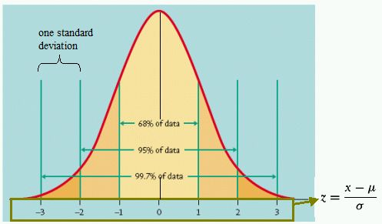

Slide 7
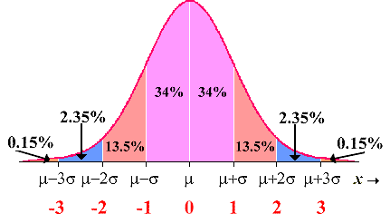

Slide 8
Sketch a normal curve for each distribution. Label the x-axis values at one, two, and three standard deviations from the mean.
mean = 95 standard deviation = 12
1.) What percent of data is between 83 and 107?
2.) What percent of data is between 71 and 83?
3.) What percent of data is greater than 119?

Slide 9
A set of data has a normal distribution with a mean of 5.1 and a standard deviation of 0.9.
Find the percent of data within each interval.
from 4.2 to 5.1 | from 6.0 to 6.9 | greater than 6.9

Slide 10
A set of data has a normal distribution with a mean of 5.1 and a standard deviation of 0.9.
Find the percent of data within each interval.
from 4.2 to 5.1 | from 6.0 to 6.9 | greater than 6.9
34% 13.5% 2.5%

Slide 11
The number of miles on a car when a certain part fails is normally distributed, with a mean of 60,000 and a standard deviation of 5000.
a. Sketch the normal curve for the distribution. Label the x-axis values at one, two, and three standard deviations from the mean.
b. What is the probability that the part will NOT fail between 55,000 and 65,000 miles?

Slide 12
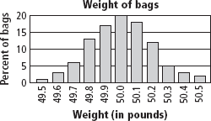
The actual weights of bags of pet food are normally distributed about the mean. Use the graph at the right for Exercises 1–4.

Slide 13
Answers
1. About what percent of bags of pet food weigh 49.9 lb–50.1 lb?
2. About what percent of bags weigh less than 49.8 lb?
3. In a group of 250 bags, how many would you expect to weigh more than 50.4 lb?
4. The mean of the data is 50, and the standard deviation is 0.2. Approximately what percent of bags are within one standard deviation of the mean weight?

Slide 14
Answers
1. About what percent of bags of pet food weigh 49.9 lb–50.1 lb? 58%
2. About what percent of bags weigh less than 49.8 lb? 25%
3. In a group of 250 bags, how many would you expect to weigh more than 50.4 lb? 5% or 12-13 bags
4. The mean of the data is 50, and the standard deviation is 0.2. Approximately what percent of bags are within one standard deviation of the mean weight? 79%

Slide 15
For Next Time
page 743 #2-5, 7-17, 23-28

